Slide 1
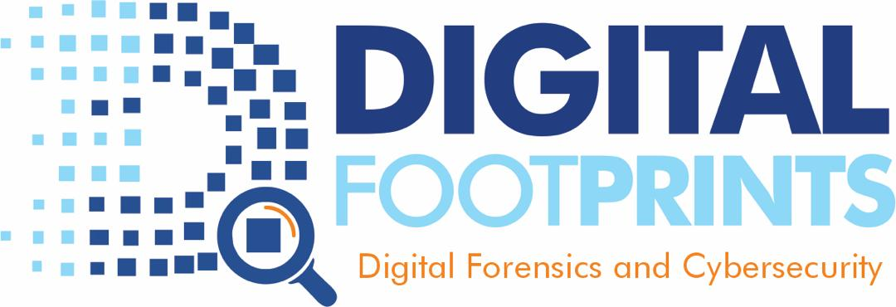
THE EMERGING CYBERSECURITY THREAT OF MIS-, DIS- AND MALINFORMATION (MDM)
Presented by:
Dr. R. Tombari Sibe, FNSE, CCISO, CCME
MD/CEO
Digital Footprints Nig. Ltd
Abuja, Nigeria
info@digitalfootprints.ng
(+234)9122800800

Slide 2
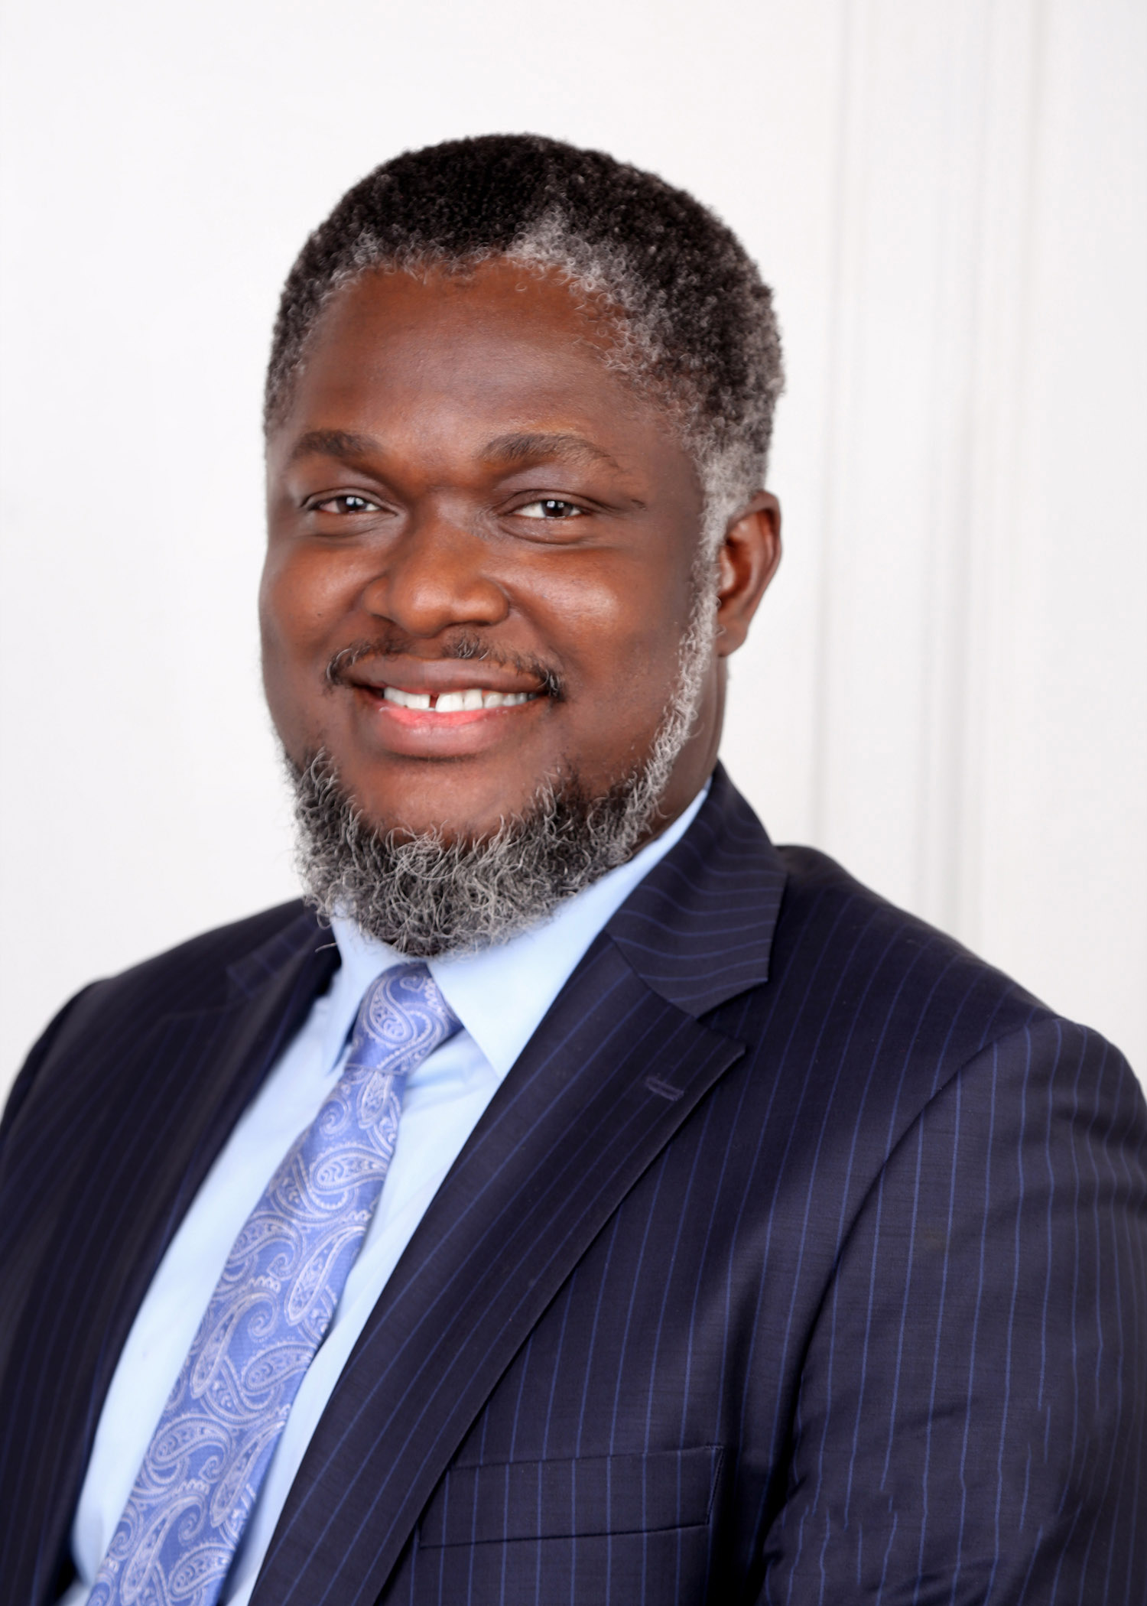
About Dr. Sibe
Dr. Robinson Tombari Sibe is a Cybersecurity and Digital Forensic Expert. He is the Co-Founder and CEO/Lead Forensic Examiner of Digital Footprints Nig. Ltd. He is a member of the Forbes Technology Council. He is also a Fellow of University of South Wales. He is also a Dissertaion Chair of Capitol Technology University, USA.
Dr. Sibe holds a PhD in Information Technology (Digital Forensics) and a Master of Science Degree in Digital Forensics, both from the University of the Cumberlands, Kentucky, USA. He also holds a Master’ Degree in Electrical/Electronic Engineering (Telecommunication) Bachelors degree in Computer Engineering.
Heis certified by EC-Council as a Certified Chief Information Security Officer (CCISO). He is also certified by the National White Collar Crime Center, USA, as a Certified Cyber Crime Examiner (3CE) and a Certified Economic Crime Forensic Examiner (CECFE). He also holds other industry certifications such as Cellebrite Certified Mobile Examiner (CCME), Cellebrite Certified Physical Analyst (CCPA), Cellebrite Certified Operator (CCO), Mobile Device Investigator (MDI), P2CO-P2C Certified Operator (Paraben), DSMO-DS Certified Mobile Operator (Paraben), etc.
He also has experience in the academia where he teaches and mentors Masters and Doctoral Students of Cybersecurity and Digital Forensics. He is a Member of High Technology Crime Investigation Association (HTCIA), a member of the Computer Technology Investigators Network (CTIN), and a member of the IEEE.

Slide 3
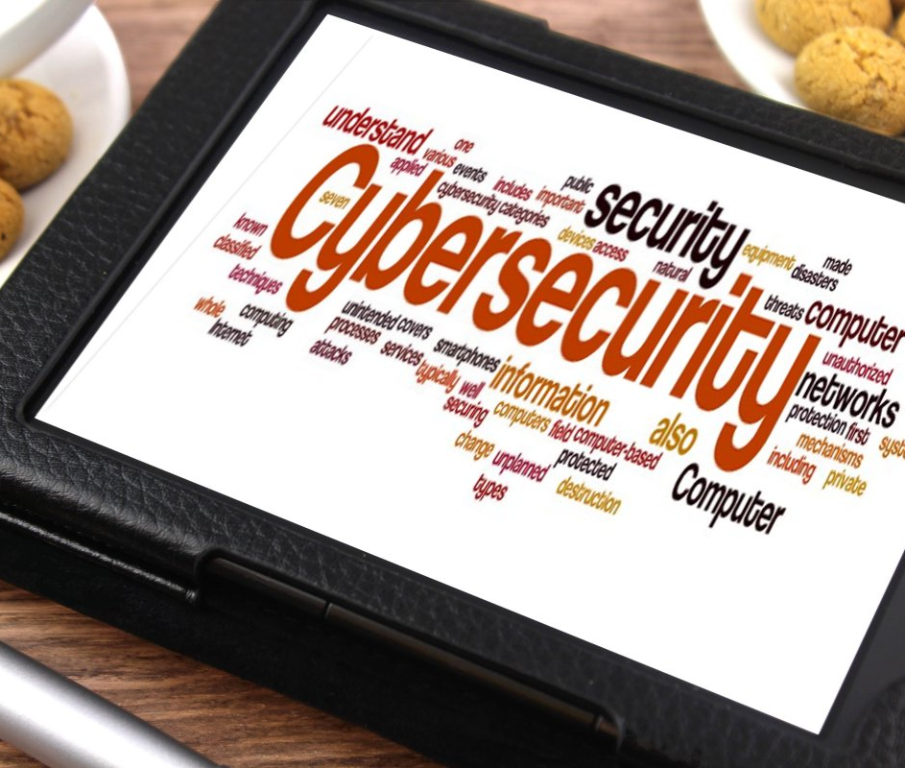
OUTLINE
Opening line
Background and Contextualization
From Nation State Actors to Cybercriminals
The Growing Threat of Dissemination
Global Cost of Disinformation
Tools for MDM
The Intersection of Cybersecurity and Disinformation
DaaS
Fighting MDM
Conclusion
This Photo by Unknown Author is licensed under CC BY-SA

Slide 4
OPENING LINE…
A lie can travel halfway around the world while the truth is still putting on its shoes. – Commonly credited to Mark Twain????

Slide 5
BACKGROUND AND CONTEXTUALIZATION - MDM
Misinformation is false or inaccurate information - APA
Disinformation is false information which is deliberately intended to mislead—intentionally misstating the facts. - APA
Malinformation refers to information that stems from the truth but is often exaggerated in a way that misleads and causes potential harm. - CCCS
Misinformation
Disinformation
Malinformation

Slide 6
FROM NATION STATE ACTORS TO CYBERCRIMINALS
Nation State Actors
Cyber Criminals
DaaS

Slide 7
THE GROWING THREAT OF DISINFORMATION
Misinformation ranked among world’s top global risk – WEF Global Risks Report 2018
87% of Executives say spread of disinformation, one of the greatest risks for business today.
Lack of regulation
Emerging technologies

Slide 8
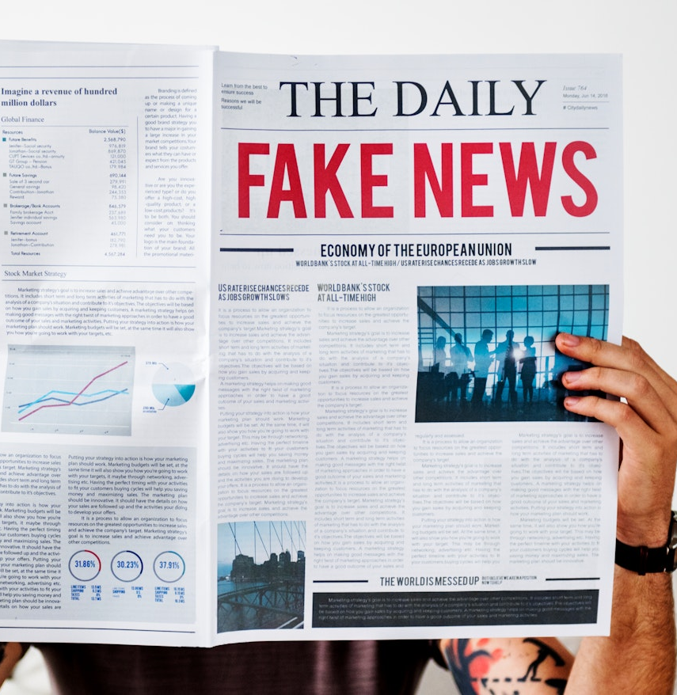
GLOBAL COST OF DISINFORMATION
Fake news costs the global economy $78 billion annually ~ CHEQ & University of Baltimore
Contributes to loss of stock market value of about $39 billion annually
Economic losses from health misinformation put at 9% billion annually
Reputational management - $17 billion annually
Platform safety efforts - $3 billion annually
$20 million allegedly spent on politically motivated fake news

Slide 9
TOOLS FOR DIS/MISINFORMATION
Social Media and Memes
Forgeries
Synthetic Media
Proxies
Content Farms
Botnets
AI
DaaS

Slide 10
THE INTERSECTION OF CYBERSECURITY AND DISINFORMATION
Cybercrime thrives with social engineering. Social engineering itself is misinformation.
Disinformation is now a service rendered by cybercriminals
DaaS and emerging technologies have democratized disinformation
Cybercriminals have weaponized disinformation
Use bots to disseminate misinformation.
Use AI technologies to evade detection.
Use stealth technology to alter message and sources to evade detection
Use of AI tools to mimic the voice of a European Energy company’s CEO and scam them of €220,000

Slide 11
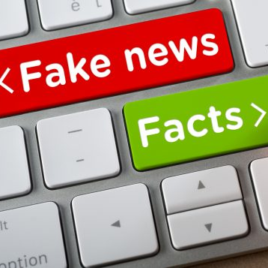
DISINFORMATION-AS-A-SERVICE
DaaS is a new model of information warfare where anyone can buy fake news and misinformation campaigns and spread them across the internet. ~ Hackernoon
Made possible by network of professional trolls, social media platforms, bots, dark web, and other online manipulation tools readily available for hire.
Key driver in the weaponization of dissemination
This Photo by Unknown Author is licensed under CC BY-SA-NC

Slide 12
FIGHTING MDM
Educate your team
Organizations need to re-evaluate their cybersecurity posture
Have a crisis response plan
Secure the information pipeline
Apply a multidisciplinary approach
Use social media monitoring tools
Practice Good information Hygiene
Implement best practice in Information Governance
Cybersecurity/Forensic Readiness
Need to strengthen regulation
Greater international collaboration

Slide 13
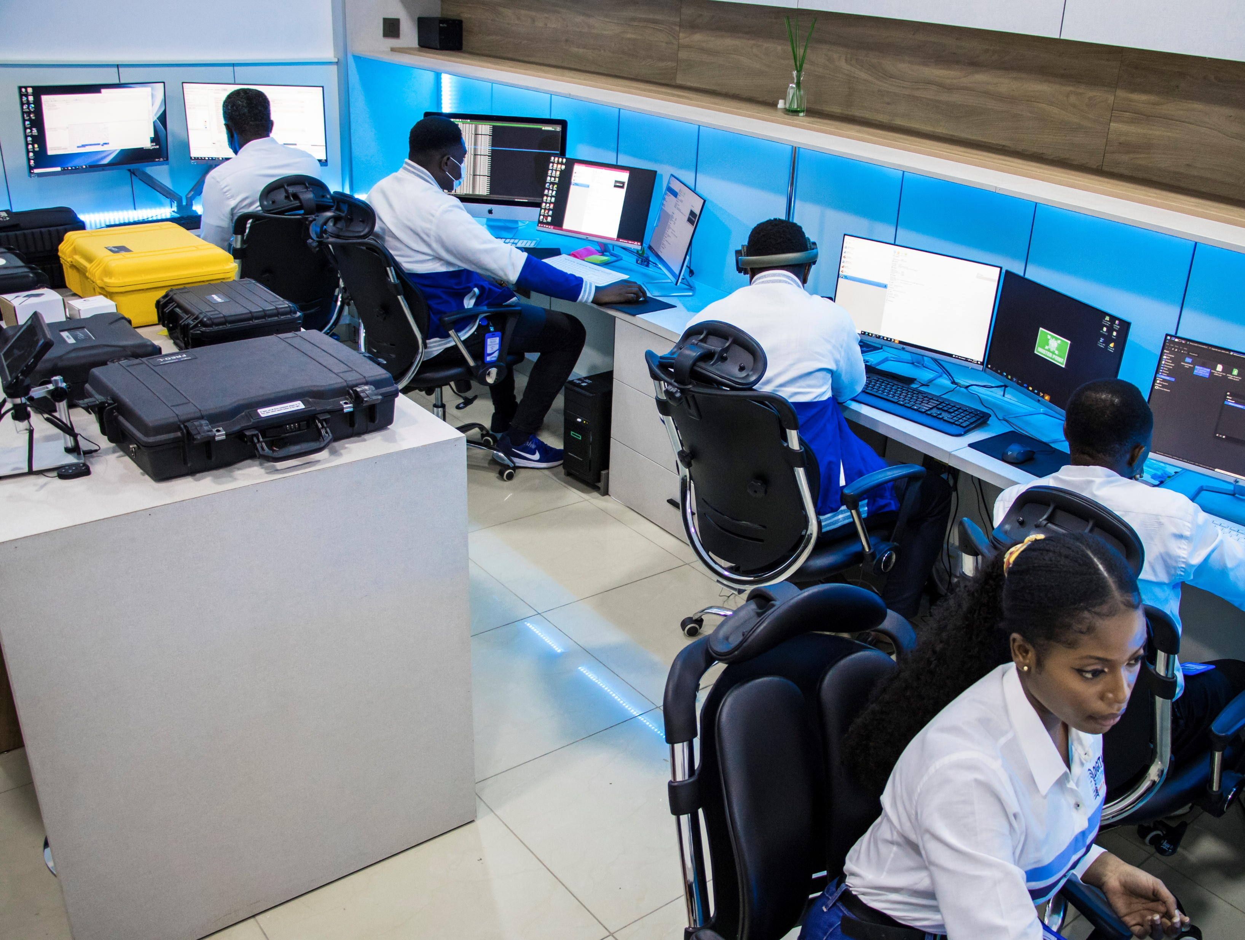
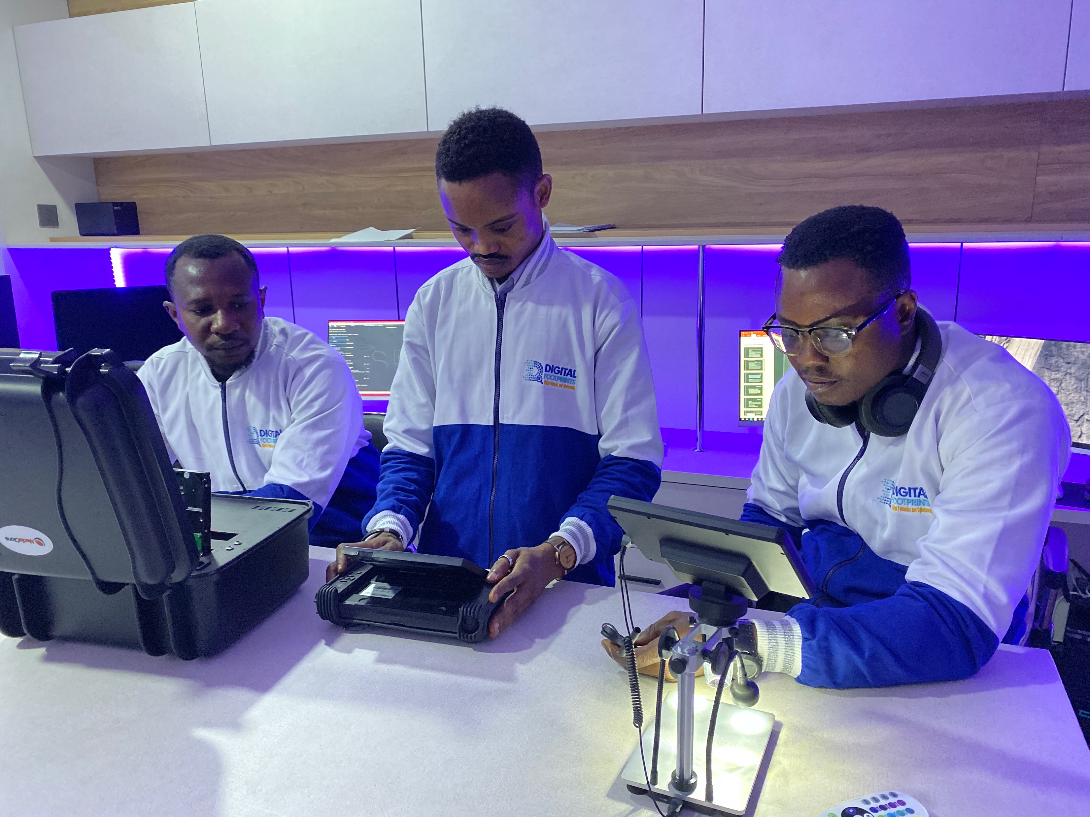
THANK YOU
Digital Footprints Nig. Ltd
Phone: 09122800800 |Email: info@digitalfootprints.ng

