Slide 1
Disinformation, A cyber-Security challenge
By Diana Tukundane Agaba
CISO, Mentor, Cyber Resilience Evangelist and Strategist
M.sc, CISSP,CISM,CDPO,

Slide 2
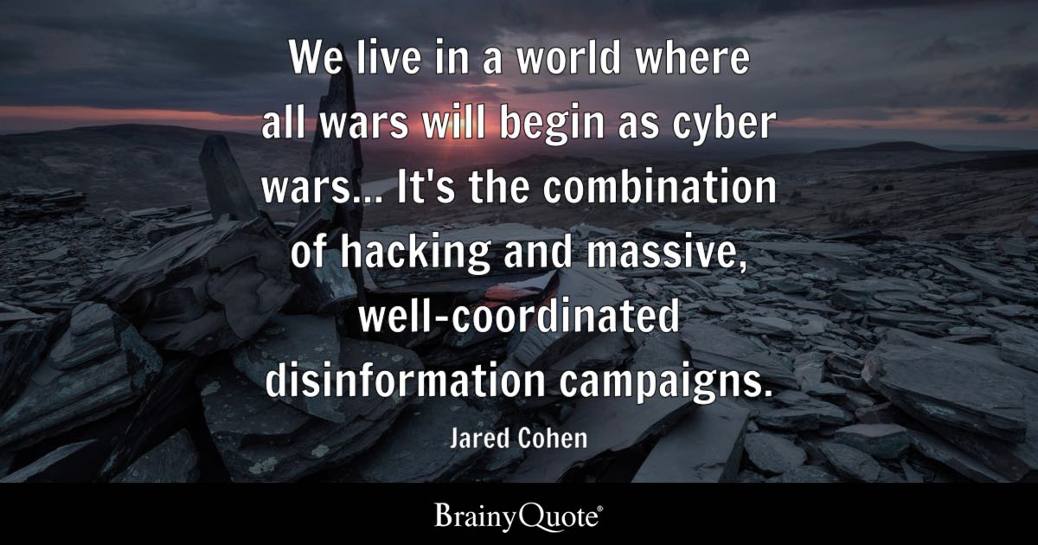
Notes:
President of Global Affairs and co-head of the Office of Applied Innovation at Goldman Sachs,

Slide 3
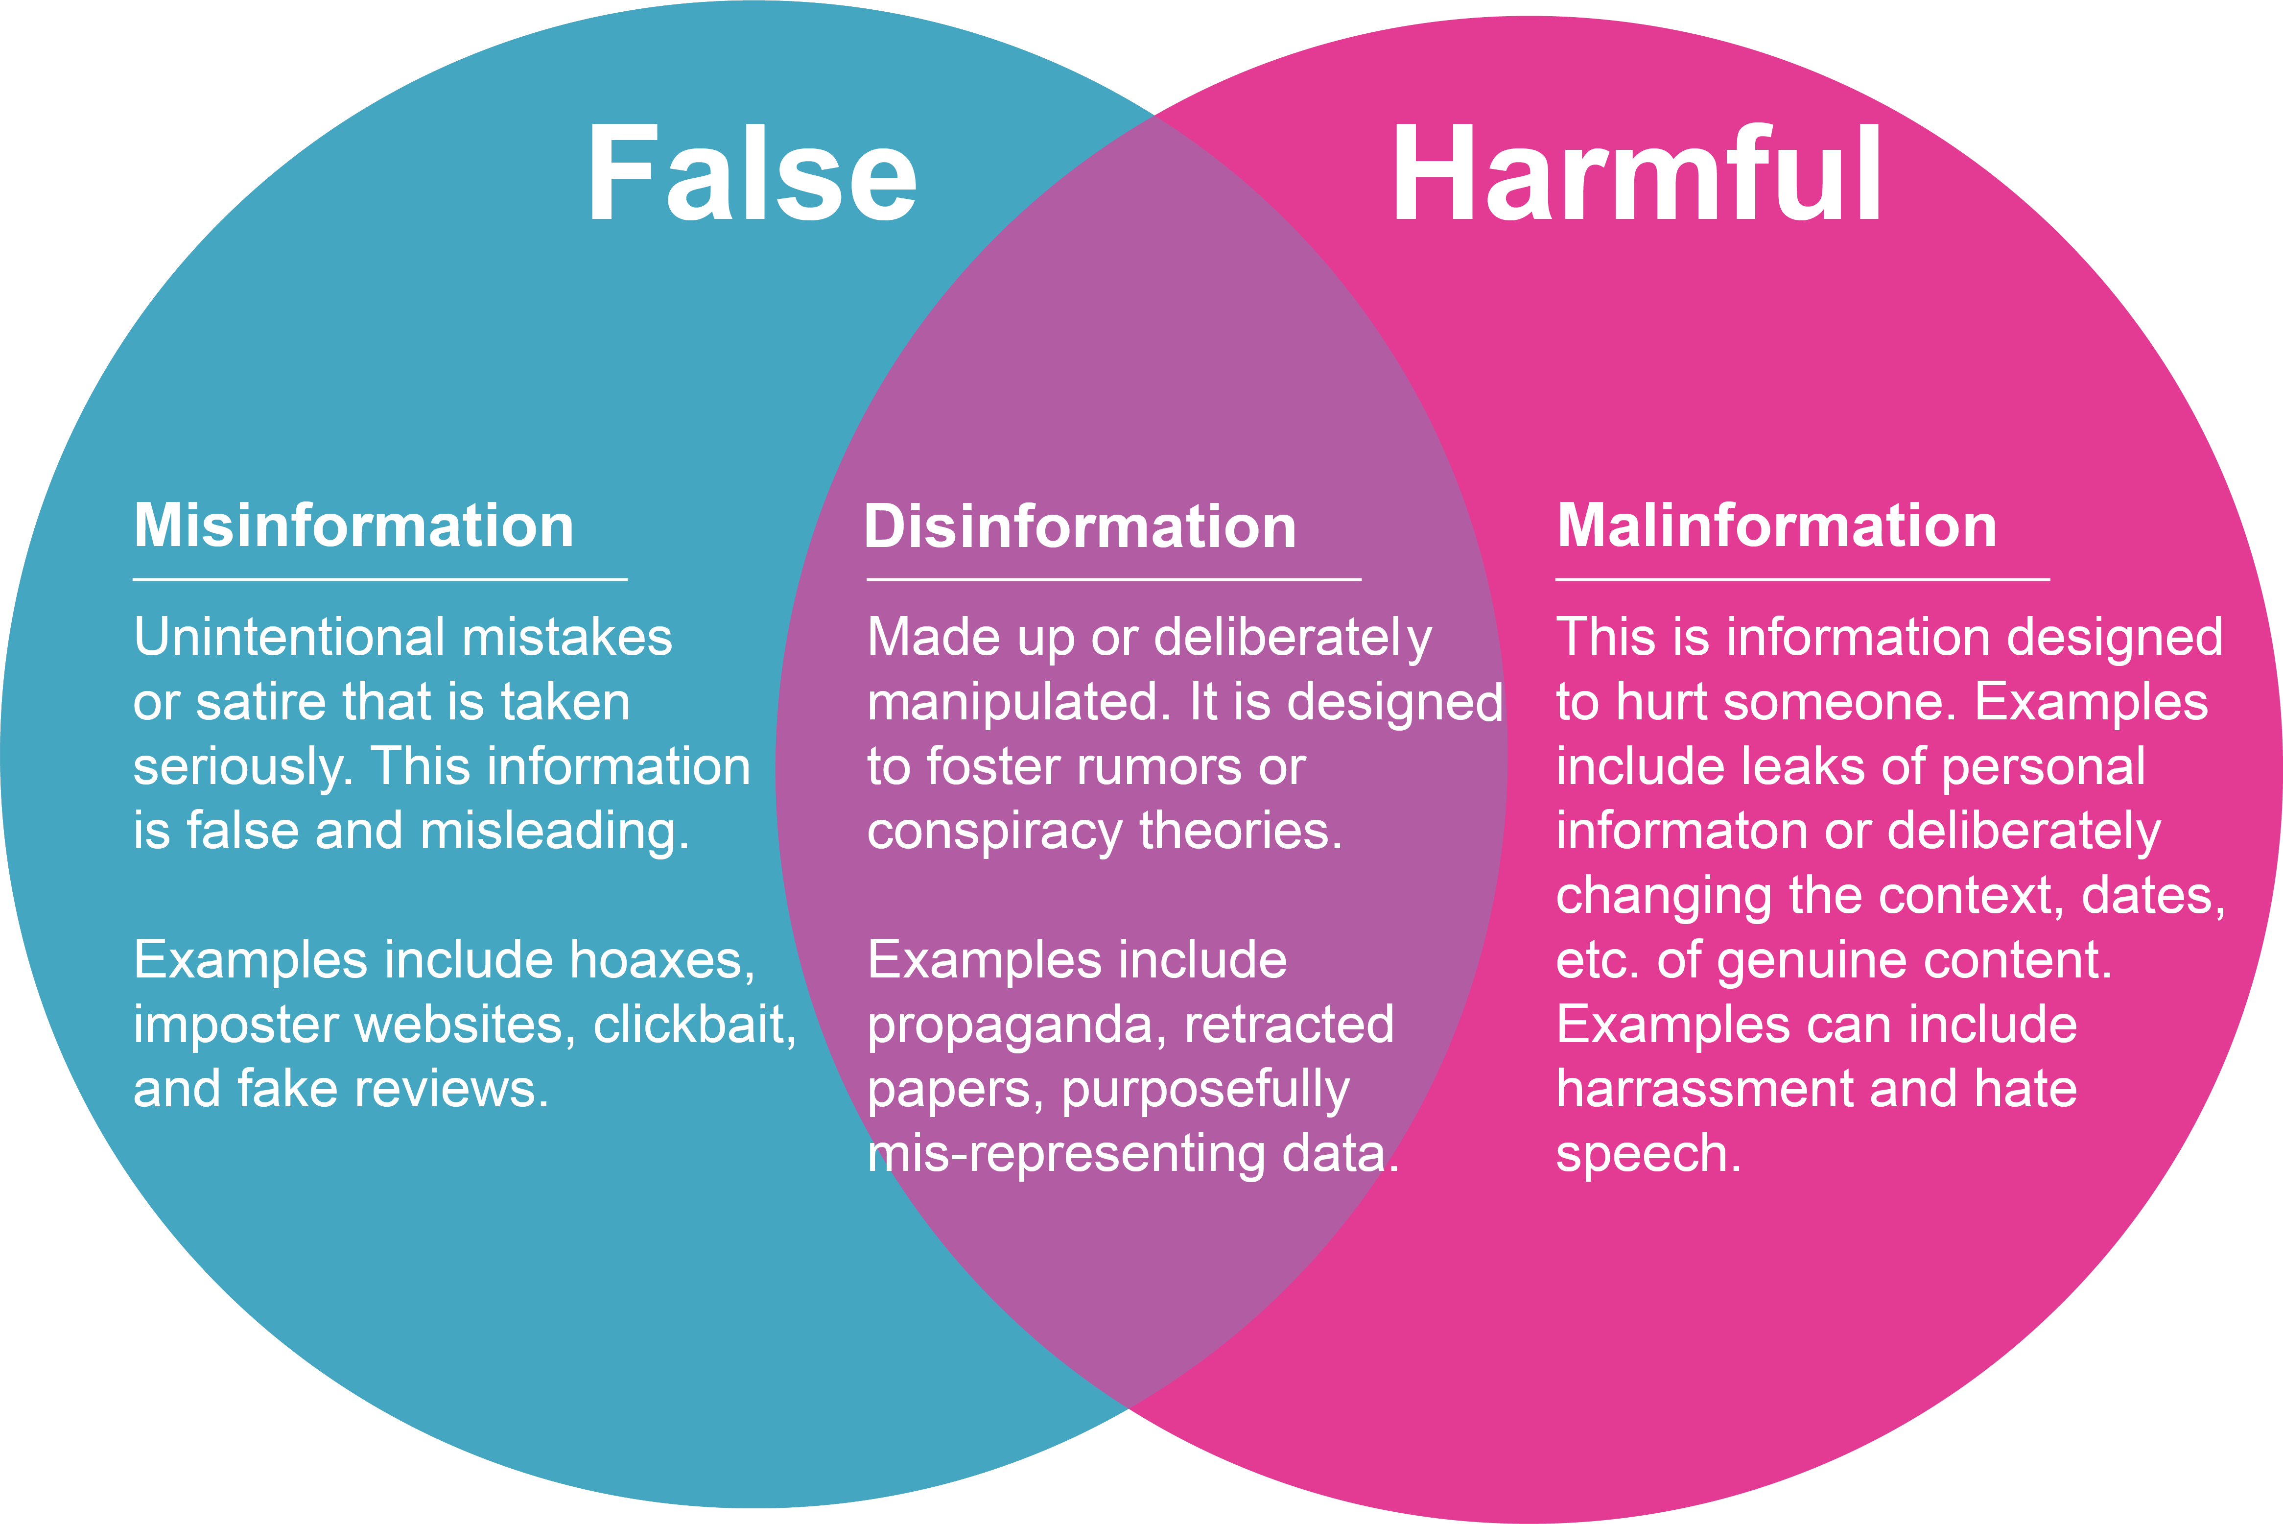
Types of False Information
Who spreads Disinformation
Foreign states
Extremist Groups
Scammers

Slide 4
Disinformation Vs Cybersecurity
Cybersecurity focuses on protecting and defending the computer systems, networks, and digital infrastructure from hacking and disrupting our digital lives
Disinformation is an attack and compromise of our cognitive being.
Nation-state actors with geopolitical aspirations, ideological believers, violent extremists, and economically motivated enterprises manipulate information to create social discord, increase polarization, and in some cases, influence the election outcome.
Nefarious actors use attacks to compromise confidentiality, integrity, and availability of the IT systems for their benefit
Cyberattacks are aimed at computer infrastructure
disinformation exploits our inherent cognitive biases and logical fallacies
cybersecurity
Disinformation
In traditional cybersecurity attacks, the tools are malware, viruses, trojans, botnets, and social engineering
Disinformation attacks use manipulated, mis-contextualized, misappropriated information, deepfakes, cheapfakes, etc.
Notes:
Disinformation is used for social engineering threats on a mass scale. Like phishing attacks to compromise the IT systems for data extraction, disinformation campaigns play on emotions giving cybercriminals another feasible method for scams.

Slide 5
Cognitive hacking: An attack and compromise of our cognitive being:
Cognitive hacking is a threat from disinformation and computational propaganda.
This attack exploits psychological vulnerabilities, perpetuates biases, and eventually compromises logical and critical thinking, giving rise to cognitive dissonance
A cognitive hacking attack attempts to change the target audience’s thoughts and actions, galvanize societies and disrupt harmony using disinformation.
It exploits cognitive biases and shapes people by perpetuating their prejudices. The goal is to manipulate the way people perceive reality.
The implications of cognitive hacking are more devastating than cyberattacks on critical infrastructure. The damage wrought by disinformation is challenging to repair.

Slide 6
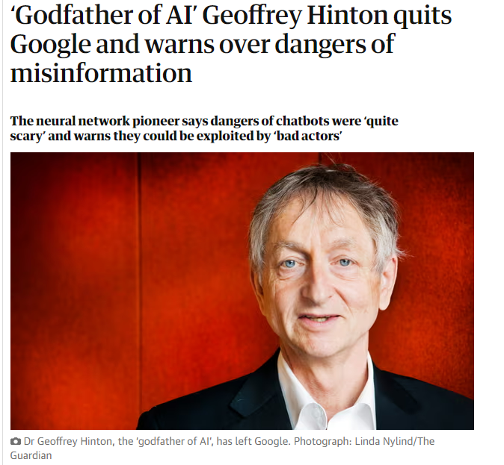
Top Concerns;
The flood of Misinformation & Disinformation
Exploitation of AI by bad actors
Possibility of AI to upend the Job Market
“existential Risk” creation of a true digital intelligence.
Source: theguardian

Slide 7
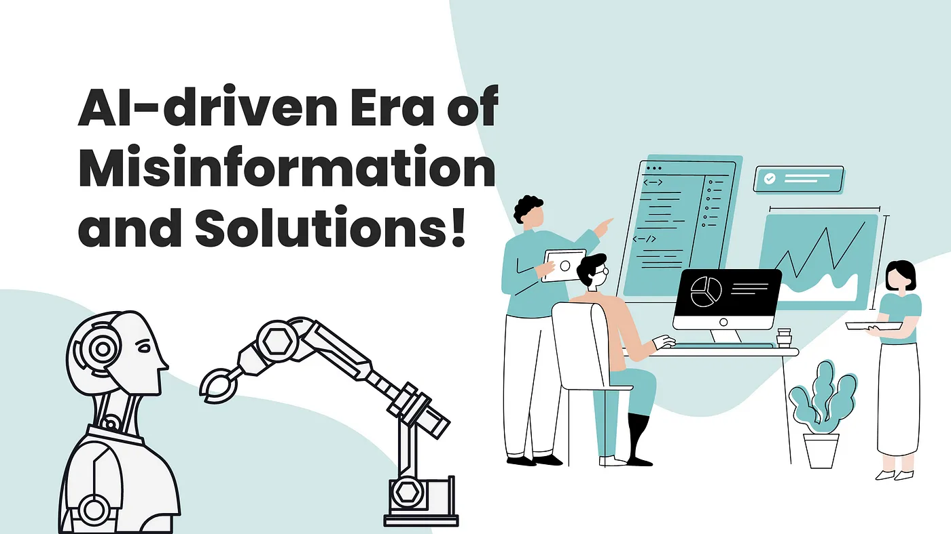
The Double-Edged Sword of Generative AI in Cybersecurity:
Top Threats and Opportunities
Threats
opportunities
Deepfake Attacks
Automated Penetration Testing
With generative AI, bad actors can now create deepfakes - hyper-realistic forgeries of images, audio, and video. Deepfakes are a potent tool for disinformation campaigns, fraud, and impersonation.
One of the promising applications of AI in cybersecurity is in automating penetration testing
Sophisticated Phishing Attacks
Intelligent Threat Detection and Response
Generative AI can learn and mimic a user's writing style or personal details, making phishing attacks far more convincing
Generative AI can help generate behavior baselines for network environments, detecting anomalies that may signify a cyber attack.
AI-Powered Malware
Adaptive Security Policies
Cybercriminals can use generative AI to develop advanced malware that adapts its code or behavior to evade detection.
AI can be used to develop and continuously update adaptive security policies. Such policies can adjust to evolving cyber threats and changing organizational needs, ensuring that defenses remain effective even as the landscape shifts.
Manipulating AI Models
VS
Phishing Simulation for Training
By exploiting the very nature of machine learning, attackers can craft adversarial inputs that manipulate AI models, causing them to make incorrect predictions or decisions
Using generative AI to create realistic phishing scenarios can provide hands-on cybersecurity training.
Automated Cyber Attacks
AI Powered Reports
Generative AI can automate cyberattacks, identifying and exploiting system vulnerabilities at high speed.
AI can automate reports and provide insights to intuitive natural language-based queries. It can eliminate the learning curve of a security system and offer valuable insights and recommendations to enhance future cybersecurity strategies and responses.
Notes:
Amit Sinha
CEO, DigiCert | Board Member Zscaler, DataRobot

Slide 8
Disinformation Stops with you
Recognize the Risk
Talk to your circle
Understand how malicious influencers use disinformation to shape the conversation and manipulate behavior. (divide Us, build a following, go viral, amplify, make it mainstream , real-world effect.)
Talk with your social circle about the risks of disinformation and how to respond when
you see it. (come prepared, decide if its worth it, respond privately, focus on the facts, be respectful, be a resource)
Question the Source.
Check who is really behind the information and think about what they gain by making people believe it. (Check the author, the date, the message, the source, the quality and for the facts.)
Thin before you link
Take a moment to let your emotions cool and ask yourself whether your feelings about the content are based on fact. (know the risk, content, facts, source, why you are seeing it, and know yourself)
Investigate the Issue
Search other reliable sources to see what they are saying about the issue. (is the source credible, what is the credible source saying, what are fact checkers saying, is your investigation neutral, does it acknowledge other perspectives?
Notes:
Source: https://www.cisa.gov/sites/default/files/publications/disinformation_stops_with_you_infographic_set_508.pdf

Slide 9
THANKS
Q & A ?

